Slide 1
Principal Component Analysis
P : 080 4928 5000 | E : enquiry@acadgild.com

Slide 2
What is pca?
Principal Component Analysis (PCA) is a dimensionality-reduction technique that is often used to transform a high-dimensional dataset into a smaller-dimensional subspace.
PCA is mathematically defined as an orthogonal linear transformation that transforms the data to a new coordinate system such that the greatest variance by some projection of the data comes to lie on the first coordinate (called the first principal component), the second greatest variance on the second coordinate, and so on.

Slide 3
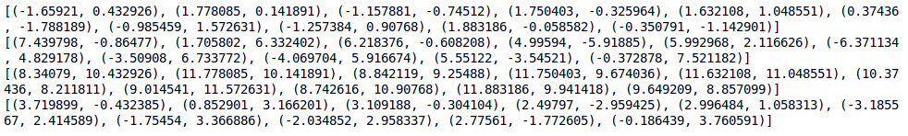
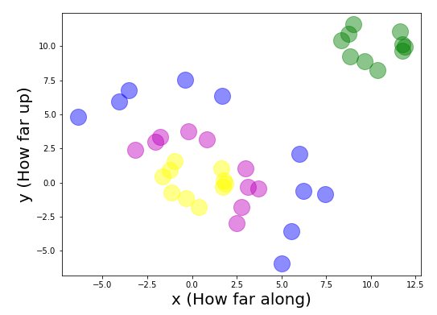
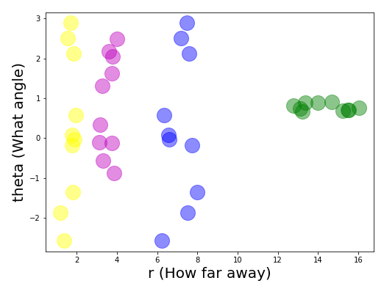
DATA TRANSFORMATION – AN EXAMPLE

Slide 5
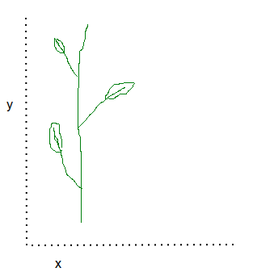
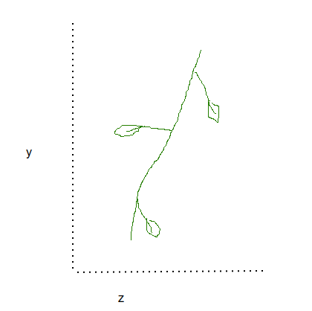
ROUGH EXAMPLE
We want to track tree growth. We have cameras to capture the tree’s front, side views.
We might be getting 4 variable values – Camera_Front_x, Camera_Front_y, Camera_Side_x, Camera_Side_y. The only variable we need for tracking growth is Camera_Front_x because it captures the change in height of the plant!

Slide 6
ASSUMPTIONS
Linear relationship between variables
Each observed variable should be normally distributed
Each pair of observed variables have a bivariate normal distribution
Variance in the data is the most important characteristic

Slide 7
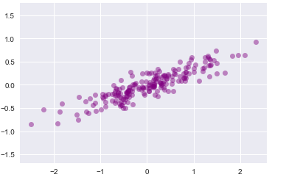
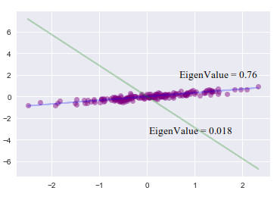
WHAT ARE PRINCIPAL COMPONENTS?
Directions in which the data has the most variance – directions in which the data is most spread out.
Mathematically, Eigenvectors of the symmetric covariance matrix of the original dataset.
Each Eigenvector has a corresponding Eigenvalue. The Eigenvalue is a scalar that explains how much variance there is in the corresponding Eigenvector direction.

Slide 8
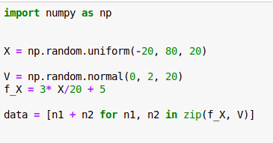
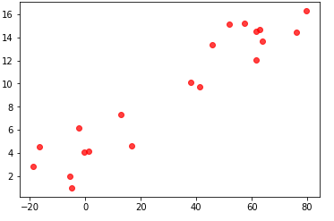
STEPS
STEP 1: GENERATE THE DATASET
X = [75.9485152, -18.70259134, 61.49631671, 63.01722673, -5.48158302, 12.69743498,
-0.35802428, 41.29395142, 1.38726451, -4.77948581, 16.65776484,
61.60904793, -2.17615326, 63.75683413, 57.3749095,
45.81783102, -16.60319893, 51.85265251, 37.97245631, 79.49058881]
Y = [14.452984095667956, 2.8477315428300667, 12.076886192408303, 14.65026019722474,
1.9551425676833882, 7.2934820757117595, 4.064118528525057, 9.682433281487526,
4.105040127162953, 0.9866854327701087, 4.603602032822884, 14.549245484131573,
6.128086363684178, 13.64291349030564, 15.188247414162976, 13.328681678515164,
4.530792443757193, 15.114534936651172, 10.137988510608203, 16.27220641213419]

Slide 9
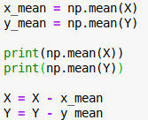
STEP 2: SUBTRACT THE MEAN
X_mean = 31.113587898
Y_mean = 9.280553140412252
After mean subtraction, X and Y become
X = [ 44.8349273 -49.81617924 30.38272881 31.90363883 -36.59517092
-18.41615292 -31.47161218 10.18036352 -29.72632339 -35.89307371
-14.45582306 30.49546003 -33.28974116 32.64324623 26.2613216
14.70424312 -47.71678683 20.73906461 6.85886841 48.37700091]
Y = [ 5.17243096 -6.4328216 2.79633305 5.36970706 -7.32541057 -1.98707106
-5.21643461 0.40188014 -5.17551301 -8.29386771 -4.67695111 5.26869234
-3.15246678 4.36236035 5.90769427 4.04812854 -4.7497607 5.8339818
0.85743537 6.99165327]

Slide 10
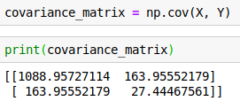

STEP 3: CALCULATE THE COVARIANCE MATRIX
Covariance Matrix = [[1088.95727114 163.95552179]
[ 163.95552179 27.44467561]]

Slide 11
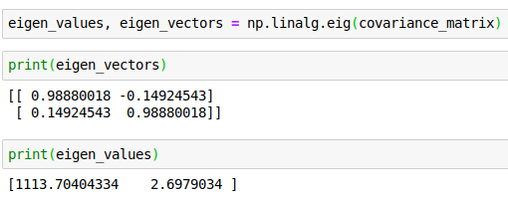

STEP 4: CALCULATE THE EIGENVALUES AND EIGENVECTORS OF THE COVARIANCE MATRIX
Solve the following equation for Eigen values, vectors
det(A – λI_{n}) = 0
eigen_vectors = [[ 0.98880018 -0.14924543]
[ 0.14924543 0.98880018]]
eigen_values = [1113.70404334 2.6979034 ]

Slide 12
APPLICATIONS OF PCA
Compression
Visualization of high dimensional data
Speeding up of Machine Learning Algorithms
Reducing Noise from data

Slide 13
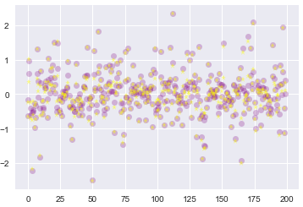
USING PCA FOR COMPRESSION
Once Eigen Vectors are computed, compress the dataset by ordering k eigenvectors according to largest eigenvalues and compute Axk
Reconstruct from the compressed version. We can reconstruct the data back by using inverse transformation mathematically represented by Axk x k.T

Slide 14
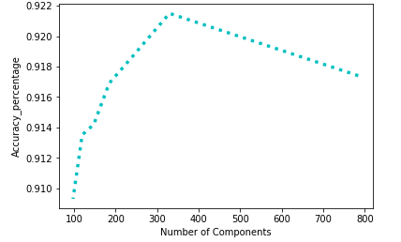
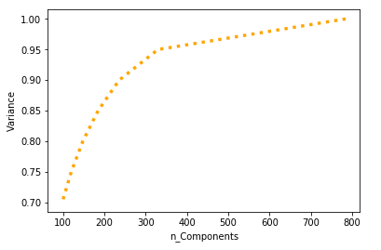
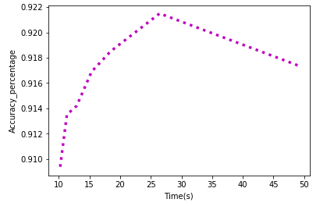
SPEEDING UP LOGISTIC REGRESSION USING PCA
Use a subset of the total number of features available for classification.

Slide 15
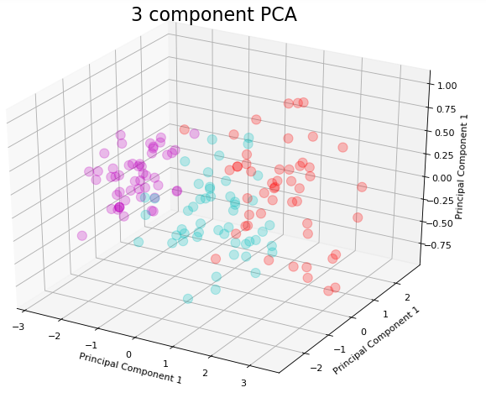
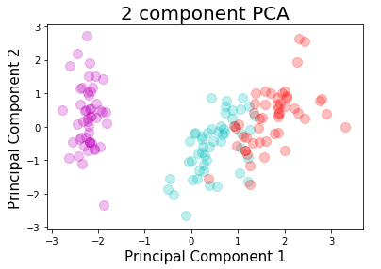
Visualization of High Dimensional Data

Slide 16
THANK YOU

